Slide 1
Title: Stratified Sampling
Aim – be able to:
Apply a stratified sample.
PBS Focus:
This week's PBS focus is treating others and ourselves with kindness and respect, as a part of Pay it Forward.
Plan:
Review median and mean
Stratified samples

Slide 2
Match up
Mean
The middle one
Median
The difference between the biggest and smallest
Mode
Add them up and divide by how many you have
Range
The most often

Slide 3
Match up
Mean
The middle one
Median
The difference between the biggest and smallest
Mode
Add them up and divide by how many you have
Range
The most often

Slide 4
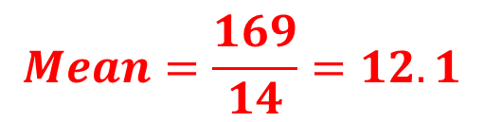
Calculate the mean
Number | Frequency | N x f
10 | 3 | 30
11 | 4 | 44
12 | 1 | 12
13 | 2 | 26
14 | 3 | 42
15 | 1 | 15
Total | 14 | 169
$$Mean=\frac{169}{14}=12.1$$

Slide 5
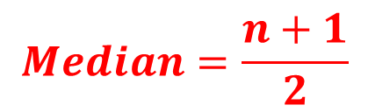
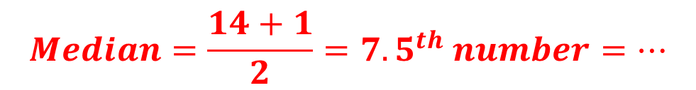
Calculate the median
Number | Frequency | Cumulative frequency
10 | 3 | 3
11 | 4 | 7
12 | 1 | 8
13 | 2 | 10
14 | 3 | 13
15 | 1 | 14
TOTAL | 14
$$Median=\frac{n+1}{2}$$
$$Median=\frac{14+1}{2}={7.5}^{th} number=…$$

Slide 6
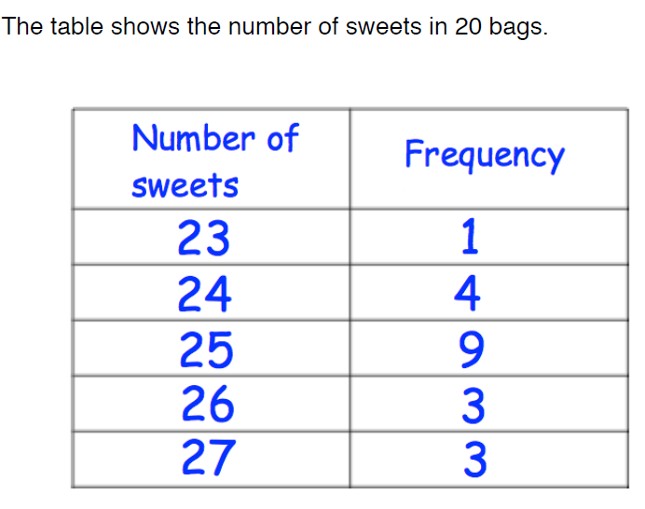
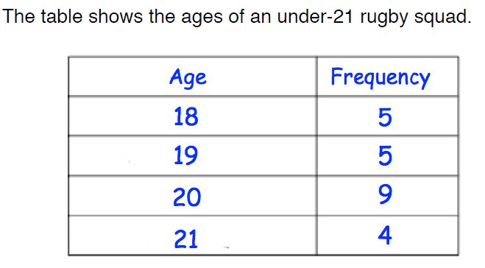
Mean and median
Answers to 1d.p.

Slide 7
Calculate the mean and median from these tables.
Mean = 25.1
Median = 25
Mean = 19.5
Median = 20

Slide 8
STRATFIED RANDOM SAMPLE
A method of sampling that involves the division of a population into smaller groups known as strata.
In stratified random sampling, the strata are formed based on members' shared attributes or characteristics (e.g. Year Group, gender, etc.)

Slide 9
STRATFIED RANDOM SAMPLE
A random sample from each stratum is taken in a number proportional to the stratum's size when compared to the population.
These subsets of the strata are then pooled to form a random sample.
Let’s see an example to put all of this in context…………………

Slide 10
Stratified sample
Divide members by total population
Multiply to sample amount (total number in survey)

Slide 11
EXAMPLE
Suppose we had a class of 30 students, that consisted of 12 boys and 18 girls.
We want to survey 10 people from the class using a stratified random sample.
These 10 students need to accurately represent the ratio of boys to girls in this class.
12:18

Slide 12
EXAMPLE
Suppose we had a class of 30 students, that consisted of 12 boys and 18 girls.
To work out the amount of boys and girls we need we need in the 10 person sample:
Boys =
Girls =
12:18

Slide 13
STRATFIED RANDOM SAMPLE
The class consists of 20 girls and 10 boys, 30 pupils altogether.
We want a sample of size 5.
Girls =
Boys =

Slide 14
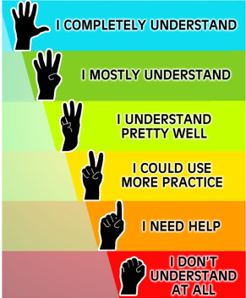

Slide 15
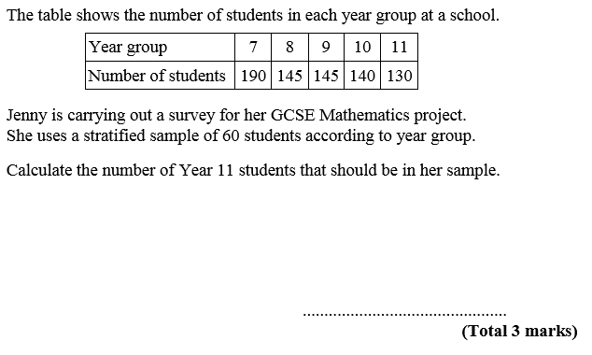
GCSE QUESTION
Σ Number of students = 750
Year 11 = 60 x $\frac{130}{750}$
we round this down to 10
$=$ 10.4
10
Notes:
Re-cap Epsilon as the notation for sum of.

Slide 16
GCSE QUESTION
Notes:
Re-cap Epsilon as the notation for sum of.

Slide 17
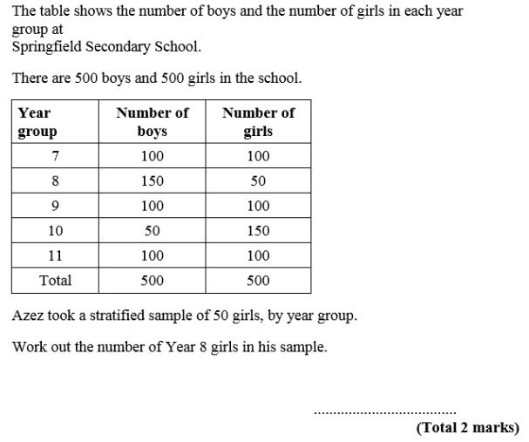

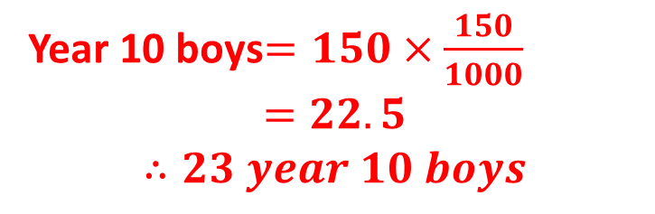
GCSE QUESTION
2. A stratified sample of 150 students was taken from the school. Work out the number of year 8 boys in the sample.
Year 10 boys$=150×\frac{150}{1000}$
$$=22.5$$
$$∴23 year 10 boys$$
1.
Year 8 girls= $50×\frac{50}{500}=5$

Slide 18
GCSE QUESTION
2. A stratified sample of 150 students was taken from the school. Work out the number of year 8 boys in the sample.
1.

Slide 19

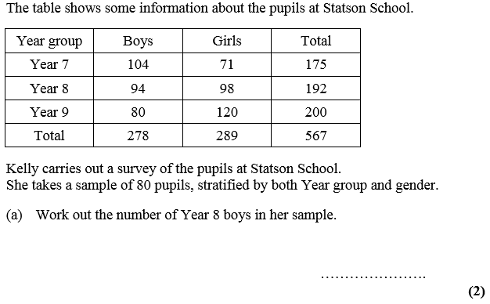
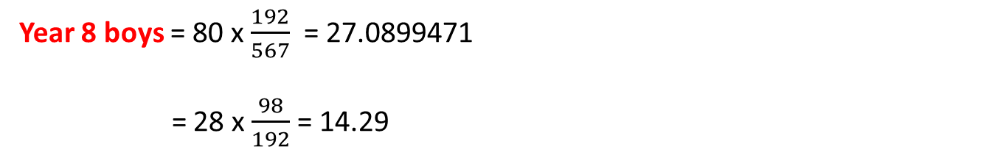
SPOT THE MISTAKES
Year 8 boys = 80 x $\frac{192}{567}$ = 27.0899471
= 28 x $\frac{98}{192}$ = 14.29
14.3
Notes:
Plenary. 3 mistakes.
1st – 27.0899471 has been rounded up, not down.
2nd – Year 8 girls (98) has been selected instead of Year 8 boys (92)
3rd – final answer should be a whole number.

Slide 20
Stratified sampling: Pros & Cons
Pros | Cons
Minimises sample selection bias (majority/ minority) e.g. makes sure certain groups of the population are not over represented. | May causing biasing through human interpretation of strata’s and their importance or impact they may have on a survey. Incorrectly identifying strata’s as homogeneous.
Able to glean more information about the strata’s | Increases errors if strata's are selected in incorrect proportion.
 | Requires and realises on the accuracy of prior knowledge.
 | Accuracy of defining or gauging strata’s. e.g. genders what defines a male or female.

Slide 21
QUESTIONS
Complete the following worksheet that contains past GCSE questions independently.
Make sure you show all of your workings!

Slide 22




Self Evaluation
Now rate your lesson using the following code:
U – Little (unsatisfactory) effort!
S – Some effort, still room for improvement!!
E – Excellent effort!!!
Little understanding
Some understanding, not completely sure
Excellent understanding

